Slide 1
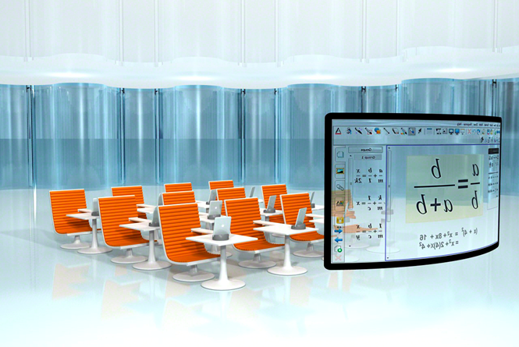
Innovative Learning Department
Digital Classrooms Plan
2016-2017
Notes:
WELCOME
INTRODUCTIONS

Slide 2

Plan components
Plan Components
As required by The State of Florida Statutes, section 1011.62(12)(b) each School Board shall submit to the department a Digital Classrooms Plan (DCP) that has been adopted by the district School Board.
The DCP shall meet the unique needs of students, schools and personnel in the district.
A District Classrooms Program allocation has been established to assist districts in this effort.
The Digital Classrooms Program outlined in statute includes five main component areas:
    1 - Student Performance Outcomes
    2 - Digital Learning and Technology Infrastructure
        3 - Professional Development
        4 - Digital Tools
        5 - Online Assessment Support

Slide 3
District Team Profile
Title/Role | Name
District Leadership Contact | Robert Runcie, Superintendent
Information Technology District Contact | Tony Hunter, Chief Information Officer
Curriculum District Contact | Dan Gohl, Chief Academic Officer
Finance District Contact | I. Benjamin Leong, Chief Financial Officer
Assessment District Contact | Richard Baum, Director Student Assessment and Research
Instructional Technology District Contact | Dr. Daryl Diamond, Director Innovative Learning
District team profile

Slide 4

Planning process
  Interdepartmental meetings began in September and presentations were delivered including:
        - Office of Academics : - District Advisory Council
        - Innovative Learning - Gifted Advisory Council
        - ESOL - Technology Advisory Council
        - Professional Development Standards and Support
        - Student Assessment and Research
        - CTACE
        - Information and Technology:
        - Network Integration
        - Technical Support Services
        - School Applications
        - Financial Services
        - Charter Schools

Slide 5
Highlighting Specific District Digital Programs
Innovations for Learning – Primary literacy program integrating classroom instruction, technology, and community-based tutors delivering high quality instruction to K -1 students
Microsoft Innovative Educator – designed to help educators move along a pathway from those who are just beginning to use Microsoft tools into the classroom to those who can become leaders of innovation in education
Global Scholars – Initiative that connects 17 participating middle school students to other participating schools around the world.
Code.org – increase access to computer science courses, curriculum and resources in schools.
Career Source Broward and Greater Fort Lauderdale Alliance – to maintain local and global perspective of industry needs and career focused technology development that impact our students upon graduation.
Ellevation In Class – offered to 100 schools and provides tools to let teachers quickly identify their ELL students and a Data Dashboard grouping students by proficiency levels
Digital Programs

Slide 6
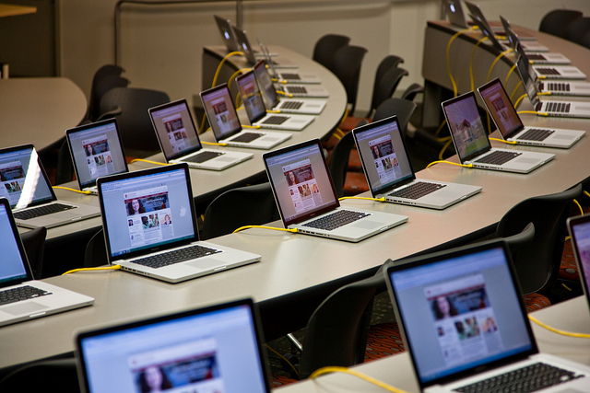
Changes in the DCP
        Changes in this year’s DCP:
        Technology Integration Matrix use will now come at a charge, whereas last year it was offered for free
        The District’s use of DCP allocation funding must
        address any device gap not allowing the
        maintenance of devices for instructional
        purposes
        The DCP must give preference to funding the number of devices that are needed to allow each school to administer the FSA to an entire grade at the same time

Slide 7
Technology Integration Matrix (TIM) and Professional Development Opportunities
Professional Development driven by technology innovation and changes in pedagogy
Used for determining technology integration in our schools
Gives us a foundation for organizing technology-related professional development and a common vocabulary regarding technology integration
Entry
Adoption
Adaptation
Infusion
Transformation
Teacher Technology Usage Level
Active
Goal Oriented
Constructive
Authentic
Collaborative
Different Learning Environments
Technology integration matrix - http://fcit.usf.edu/matrix/matrix.php

Slide 8
Professional Development Enabling Movement through TIM Levels of Technology Integration
Level 1
The 21st Century Learner Qualification
Level 2
The 21st Century Educator Qualification
TIM Adaptation Level
Level 3
The 21st Century Collaborator Qualification
TIM Infusion Level
Level 4
TIM Entry and Adoption Levels
The 21st Century Innovator Qualification
TIM Transformation Level
Redbird professional development

Slide 9
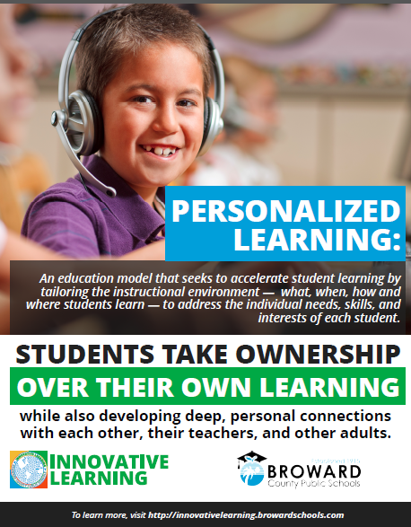
Personalized learning and digital classrooms
Personalized Learning and Digital Classrooms
Digital Classroom:
2013-2014 – 27 Digital 5 Schools
2014-2015 – 69 Digital Schools
2015-2016 – 84 Digital Schools
2016-2017 – 100 Digital Schools
Infrastructure Upgrades
Meeting specialized technical requirements of District educational programs (ESE, Magnet, ELL, Online and Blended Courses, Adult Education)
Create, curate, and procure digital curriculum for the LMS (Vocabulary.com, Newsela, and Learning.com)

Slide 10
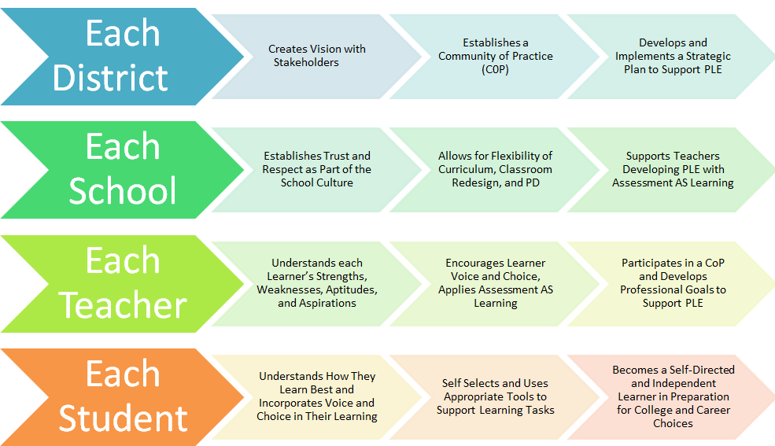
Personalized Learning
Teach to One - http://www.newclassrooms.org/
Summit Basecamp - https://www.summitlearning.org/
Waggle Practice - http://www.wagglepractice.com/
New programs for personalized learning environments

Slide 11
Component 1 - Student Performance Outcomes
Student Performance Outcome | Baseline | Target
Increase percentage of fifth grade students in the Digital 5 Personalized Learning initiative performing at FSA proficiency levels in mathematics, reading and science | FSA (non – EOC) Math – 58% FSA ELA – 52% Science – 45% * Based on 99 D5 schools, Total School Data | 2017 FSA Math – 63% FSA ELA – 58% Science – 50%
Increase access to learning management system to targeted D5 and Digital Infusion program students and teachers for instruction, assessment, and progress monitoring | 100% - all digital 5 classrooms have access to the LMS Digital Infusion Programs – 35% | 2017 100% 50%** ** All teachers have access to Canvas and their classes have been rostered in the LMS. These percentages would be actual usage of the LMS.
Increase percentage of targeted fifth grade elementary students with basic keyboarding skills | 20% *** *** Selected schools are going to be implementing Learning.com that teaches basic keyboarding skills and digital literacy. | 2017 80%
Increase percentage of targeted D5 and Digital Infusion program students meeting digital literacy standards as defined by ISTE national standards | 35% *** | 2017 80%
Create grade level personalized learning paths for students within a learning management system | 45% | 2019 100%
Student performance outcomes

Slide 12
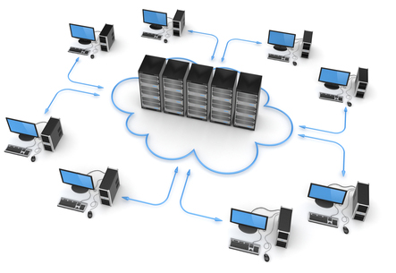
Component 2 - Digital Learning and Technology Infrastructure
Ensure higher bandwidth wireless access in all classrooms
Upgrade LAN network equipment where needed to support new
wireless access points
Upgrade WAN circuits to 1 gbps to the District’s network core
Upgrade core network electronics to manage the District’s WAN/Data Center/Internet convergence
Upgrade bandwidth provisioning on the District’s Internet circuits
IMS Global Learning Consortium member enabling a plug and play architecture to allow for rapid deployment of innovative products working together
Student performance outcomes

Slide 13
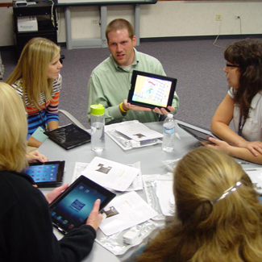
Component 3 - Multi-Tiered Professional Development
Provide stipends to qualified teachers who have completed professional learning to develop curriculum content for LMS content repository including but not limited to the 10 – module online Canvas course.
Provide stipends to district and school-based instructional staff who complete the one month online TIM training offered by the DOE
followed by the one-day district-wide TIM training.
Deliver Level 1 – Level 4 training towards a
21st century credential through the Redbird PD platform.
Electronic TIM Tool training for school and district-based
administrators, instructional coaches and instructional staff
Professional development opportunities

Slide 14

Component 4 - Digital Tools
Renewal and expansion to more schools of specific district-wide software (Learning.com, Vocabulary.com, Newsela)
Canvas Learning Management System annual costs
Consultant costs associated with specific software and digital equipment and tools
Create, curate and procure digital content
Computer devices to meet state device
worksheet
Digital tools and content

Slide 15

Component 5 - Online Assessment Support
Computer- based Testing Readiness Certification
Continue to procure digital devices to support online assessment
Continue to update the network, bandwidth, and wireless infrastructures to meet the FDOE technology specifications.
Online assessment support

Slide 16
2016-2017 DCP Broward - $4,739,980
Allocated to charters - $691,480 remainder - $4,048,500
Allocations for 2016 - 2017
Key Component | Cost | Description
Credentialed Professional Development | $120,000 | One-time stipend for curriculum development by teachers
 | $25,000 | One-time stipend for teachers who complete TIM training
 | $7,500 | TIM – O training costs
 | $150,000 | Redbird Professional Development Platform (Balance of payment coming from Title IIA funds)
Digital Tools | $1,050,000 | Software Renewals (Learning.com, Vocabulary.com, Newsela)
 | $1,500,670 | Learning Management System Year 2
 | $690,000 | Laptops to fill gap for testing
 | $500,000 | Consultant costs for digital tools
TOTAL | $4,043,170

Slide 17

questions

Slide 18
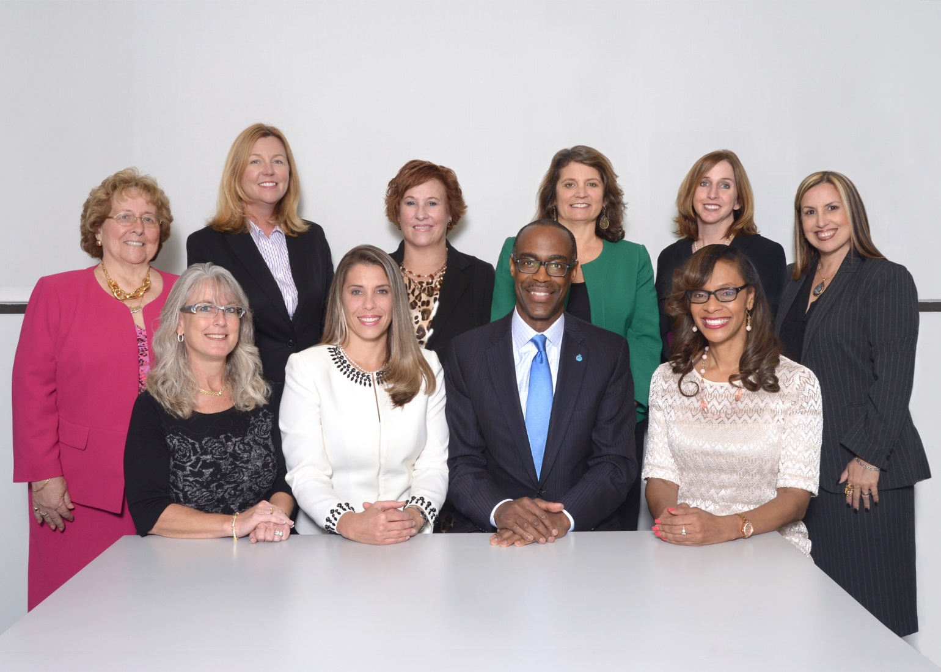
Dr. Rosalind Osgood, Chair
Abby M. Freedman, Vice Chair
Robin Bartleman
Heather P. Brinkworth
Patricia Good
Donna P. Korn
Laurie Rich Levinson
Ann Murray
Nora Rupert
Robert W. Runcie
Superintendent of Schools

